Slide 1
Cloud Adoption Framework for Azure Getting ready to deploy workloads

Slide 2
Azure Virtual Workshop:
Prepare your landing zone using Cloud Adoption Framework
Morning: Overview/Ready/Govern/Manage – 3 hrs.
Level | Duration | Content
L100 | 30min | Cloud Adoption Framework Overview Provide an overview of the Cloud Adoption Framework and help customers think about their cloud strategy and create an actionable cloud adoption plan.
L200 | 60 min | Unlock cloud adoption using Azure landing zones Provide an overview of the Azure landing zones, why are they important and what are the different landing zones implementation options. Customers will also go through an operating model exercise to decide what option would best suit their needs.
 | 45 min | Establish cloud governance using the Cloud Adoption Framework Leverage the agile, iterative methodology to enable governance maturity without impeding migration or innovation.
L200 | 45 min. | Manage your cloud operations to achieve business value Learn the best practices to support ongoing cloud operations to deliver tangible business outcomes.
Afternoon: Hands-On Exercises – 3 hrs.
L300 | 15 Min. | Introducing Hands-on-lab(HOL) process & goals for the afternoon
 | 30 min | HOL 1: Start small and expand landing zone implementation option
 | 45 min | HOL 2: Governance Create a governance MVP by setting up management groups, resource groups, cost management and RBAC
 | 60 min | HOL 3: Enterprise scale landing zones lab
 | 30 Min. | Next steps & how to get started

Slide 3
Agenda
Overview of the Microsoft Cloud Adoption Framework for Azure
What is an Azure Landing Zone
Operating Model
Implementation Options

Slide 4
Overview of the Microsoft Cloud Adoption Framework for Azure
Notes:
Ref: https://docs.microsoft.com/en-us/azure/cloud-adoption-framework/overview

Slide 5
Microsoft Cloud Adoption Framework for Azure Proven business and technical guidance to help customers create and implement the business and technology strategies necessary to succeed in the cloud.
Define strategy
Define business justification and expected outcomes
Plan
Align actionable cloud adoption plan to business outcomes
Ready
Prepare people, process and environment for change
Adopt
Migrate or Innovate
Implement desired changes across IT and business processes
Govern
Comply, control and secure
Manage
Operate and optimize
https://aka.ms/adopt/overview
Notes:
<Key point>: Cloud Adoption Framework—modular phases of adoption.
As your organization evolves, the Cloud Adoption Framework adapts to your business needs.
Each module in the diagram is an iterative phase that advances your business through the complete lifecycle of cloud adoption.
Customers can choose the phase best-suited to their degree of cloud adoption maturity. The Cloud Adoption Framework offers a guiding methodology to cloud adoption, with specific approaches to overcoming common blockers to cloud adoption in each module, such as “Define Strategy,” “Plan,”, etc.
The Cloud Adoption Framework offers the enterprise a modular framework of how to incrementally onboard to the cloud.
Cloud adoption shifts how companies obtain, make use of, and lock down their technology resources.
And—this kind of modular framework flips the model of how enterprises operate:
Transitions organizations to need-based consumption of technology resources
Change from cap-ex (capital expenditure) to op-ex (operating expenditure) model
Cloud model assumes security, governance, cost-optimization, and hybrid cloud by default
Develop a future-ready workforce—developing and deploying cloud skill readiness organization-wide
As an organization progress through the Cloud Adoption Framework, what are the main goals of each methodology of “Define Strategy,” “Plan,” you can focus efforts on?
<Transition>: Now that we have taken look at the phases and modular approach, lets look at about some common business blockers that the Cloud Adoption Framework can help you resolve.

Slide 6
Landing zone development approach

Slide 7
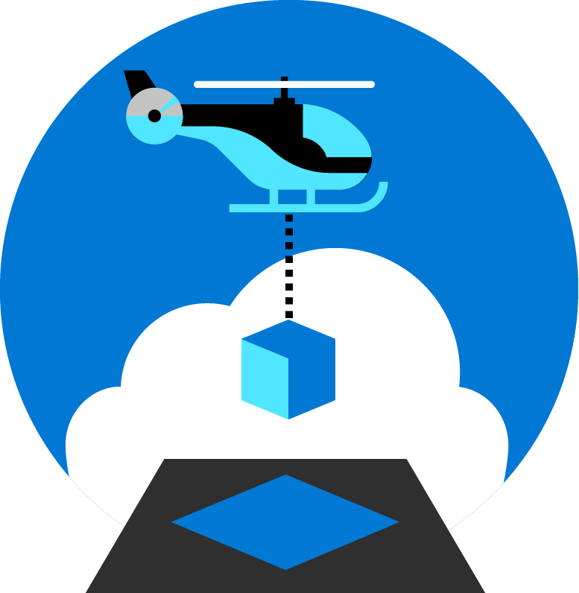
Azure landing zones help customers set up their Azure environment for scale, security, governance, networking, and identity.
Azure landing zones:
Enable migrations and net new apps
Consider all platform resources
Don't differentiate between IaaS or PaaS

Slide 8
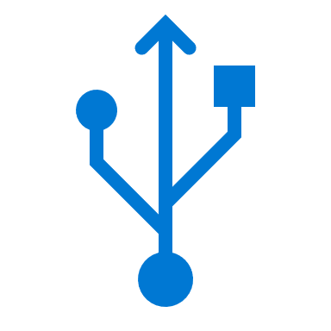
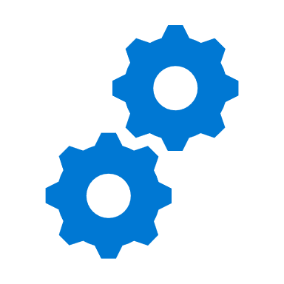
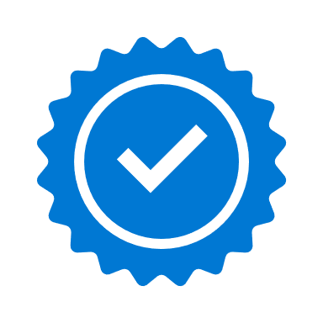
Key Challenges
Architecture Complexity
Customers lack the required level of understanding and experience on Azure. The mismatch between on-premises infrastructure and cloud-design considerations creates dissonance and friction with respect to defining architectures and standards for their migration to the cloud. They are struggling with the translation of their requirements to Azure concepts, capabilities, constructs and security model.
Operating Compatibility
Existing approaches and functions for the traditional delivery and management of IT services are not compatible with the Azure platform and cloud operating models. When combined with a lack of skills and experience, customers are struggling to define and therefore transform their operating model to manage and support large-scale cloud infrastructure.
Lack of Trust and Desire for Control
The absence of a precise and detailed cloud architecture that is compliant with their requirements, and the lack of a well-defined operating model to support such a platform, leads IT not to trust Azure and instead strive to maintain full control. This often involves building ‘walls’ and complicated processes which ultimately get in the way of business lines adopting Azure.

Slide 9
Common path – common blocker Acting too soon
100% alignment on the Azure environment
First workload
First 10 workloads
First production workloads
First 100 workloads
Notes:
In the image above, the customer has an objective of 100 workloads living in the cloud. To get there, the customer will likely deploy their first workload. Then their first 10 or so workloads, before they are ready to release one of those workloads to production. Eventually, they will reach the objective of the adoption plan and have a robust portfolio in the cloud. However, the red X in the image shows where customers commonly get stuck. Waiting for 100% alignment can delay the first workload by weeks, months, or even years.

Slide 10
Common path – common blocker Acting too late
First workload
First 10 workloads
First production workloads
First 100 workloads
Enterprise readiness
Notes:
Similar to acting too soon, in this image, the customer waits too long to reach enterprise ready environment (enhanced requirements needed by security, operations, and governance teams) across landing zones. By waiting too long, the customer will be constrained on the amount of refactoring and expansion they can do in the environment. Those constraints will limit their ability to drive continued success.

Slide 11
Azure landing zones Design areas

Slide 12
Azure landing zones Design areas
Enterprise Enrollment
Business Continuity & Disaster Recovery
Identity
Governance Disciplines
Resource Organization
Deployment Options
Network Topology & Connectivity
Operations Baseline
Notes:
There are different Azure landing zone implementation options and each of them provide a different deployment approach. Before choosing an implementation option, let’s talk about the design areas for Azure landing zones.
Talking points ---
Enterprise enrollment: IF you are making a commitment to use a specific amount of Azure, you'll want to consider how your EA enrollment is configured & ensure your Azure AD tenant is aligned.
Identity: Are you using your existing Azure AD tenant from Office 365 by applying RBAC? Or do you have deeper security requirements that require more considerations?
Resource organization: Get a jump on cloud governance by preparing for proper resource organization early. This includes things like naming, tagging, subscriptions, resource groups, and management groups. Good design now will make portfolio governance easier later
Network Topology & Connectivity: are the two must have considerations. Until you understand how things connect to in the cloud & how people gain access, you can't really use the cloud
Business continuity and disaster recovery - BCDR provides the foundation for reliability and rapid recovery. BCDR isn't really a design area, its a discipline under CAF Manage. i don't generally talk to it as a pillar, even though its on the design areas page. if anything just a brief mention of it during the Operations baseline talking point.
Governance disciplines: Begin including the governance disciplines in every landing zone to get an early start on governance, security baseline, and compliance policies.
Deployment options: Azure landing zones provide a variety of deployment options to fit your operating model
Operations Baseline: Get a jump start on operations management (CAF Manage) by preparing each landing zone for visibility, operational compliance, and protect/recover processes.

Slide 13
Start with enterprise scale
Cloud platform
Cloud adoption: migrate or innovate
Implement Enterprise Scale
First workload
First 10* workloads
First production workloads
100+ workloads
The reference implementations of CAF Enterprise Scale provide a rapid implementation option, aligned to an Enterprise Operations model using cloud native security, governance, and operations management tools.

Slide 14
Start small & expand
First workload
First 10* workloads
First production workloads
100+ workloads
Cloud adoption: migrate or innovate
Start small landing zones
Connected environments
Secure landing zones
Shared services model
CCoE and operating model
Cloud platform
The CAF Start small blueprints initiate a parallel development path. As cloud adoption expands, Central IT or CCoE teams expand the cloud platform to support the adoption plan.

Slide 15
Operating model
Notes:
Ref: https://docs.microsoft.com/en-us/azure/cloud-adoption-framework/ready/considerations/enterprise-scale

Slide 16

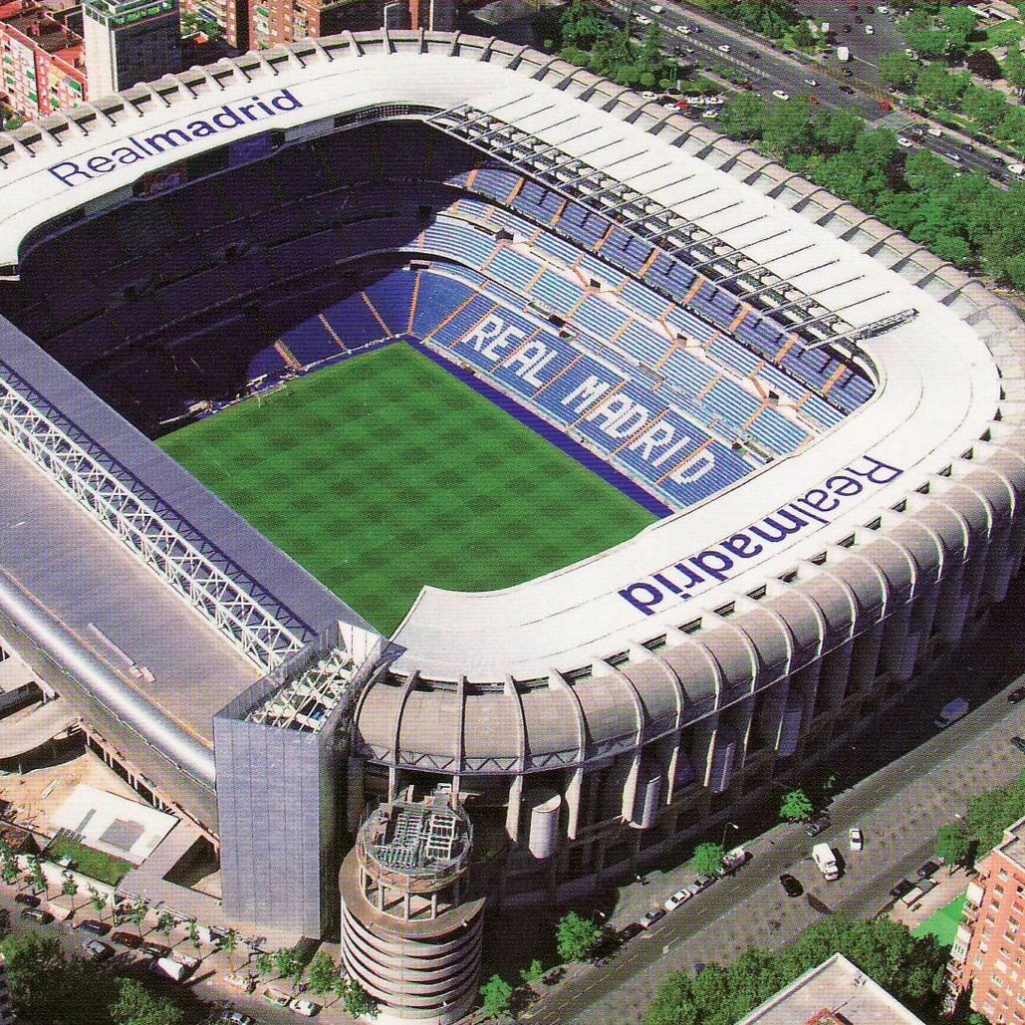

What are you going to build? Your foundation is created to serve a specific purpose
A house
A stadium
A bridge

Slide 17
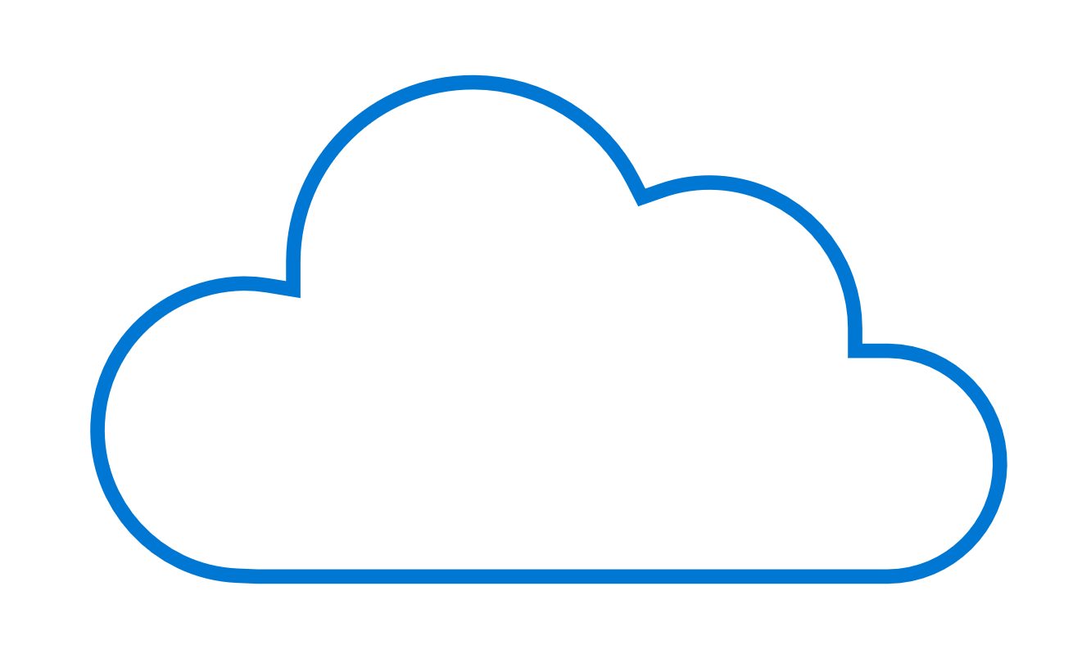
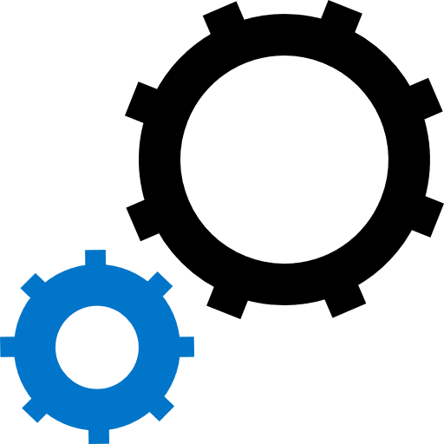

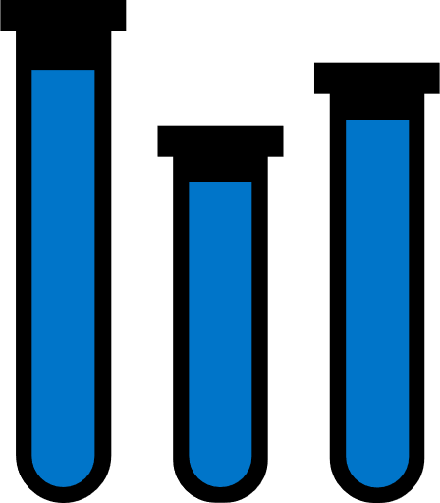
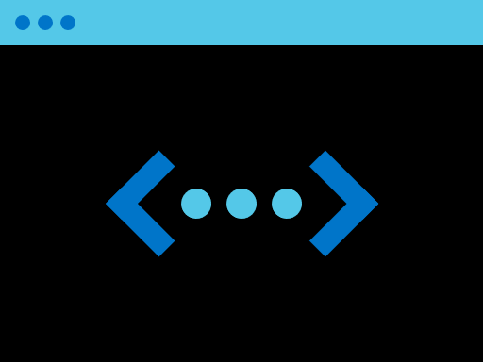
Foundations in the cloud
Workload
W
W
Assets (Resources in Azure)
Workload
Workload
W
W
W
Workload
Foundation Utilities
W
W
W
W
W
Workload
Workload
Workload
Landing zone
Landing zone
Landing zone
Workload
Landing zone
Platform foundation
Foundation utilities

Slide 18
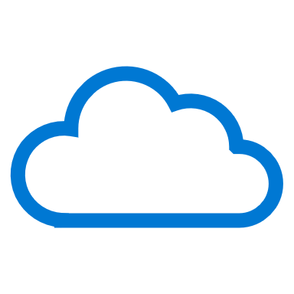

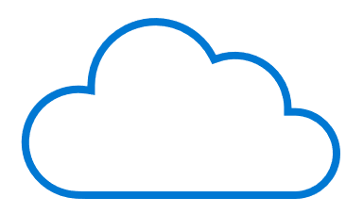

Your foundation should align to your desired Cloud Operating Model
W
W
W
W
W
W
W
W
W
W
W
W
W
Distributed Operations
W
W
W
W
Enterprise Operations
W
W
Environmental complexity
Central Operations
W
W
Workload
Landing Zones
Platform Foundation
Decentralized Operations
Notes:
Remember when I was talking about what you are going to build, and how important is to know that so you have the right foundation.
Maturity on cloud adoption and complexity grows as the cloud operating model gets more complex and align to that the landing zones grows in complexity.
Talking points
Workload operations → Fully decentralized → focus on WAF guidance
Central operation → Central IT services → start small and expand (CAF Migration/Foundation blueprints or Terraform)
Portfolio operations → Cloud Center of Excellence → rich initial implementation (ESLZ)
Global operations → complex operating models → combination

Slide 19




Find the closest model to your needs
W
W
W
W
W
W
W
W
W
W
W
W
W
W
W
W
W
W
W
W
Decentralized Operations
Central Operations
Enterprise Operations
Distributed Operations
Which motivation is your highest strategic priority?
Innovation
Control
Democratization
Integration
What is the scope of your portfolio?
Workload
Landing zones
Cloud platform
Complex portfolio
Who’s accountable for governance, security, and operations decisions?
Workload Teams
Central IT
Cloud Center of Excellence
Mix of all three or unknown
Notes:
Remember when I was talking about what you are going to build, and how important is to know that so you have the right foundation.
Maturity on cloud adoption and complexity grows as the cloud operating model gets more complex and align to that the landing zones grows in complexity.
Talking points
Workload operations → Fully decentralized → focus on WAF guidance
Central operation → Central IT services → start small and expand (CAF Migration/Foundation blueprints or Terraform)
Portfolio operations → Cloud Center of Excellence → rich initial implementation (ESLZ)
Global operations → complex operating models → combination

Slide 20
Implementation options
Notes:
Ref: https://docs.microsoft.com/en-us/azure/cloud-adoption-framework/ready/considerations/enterprise-scale

Slide 21
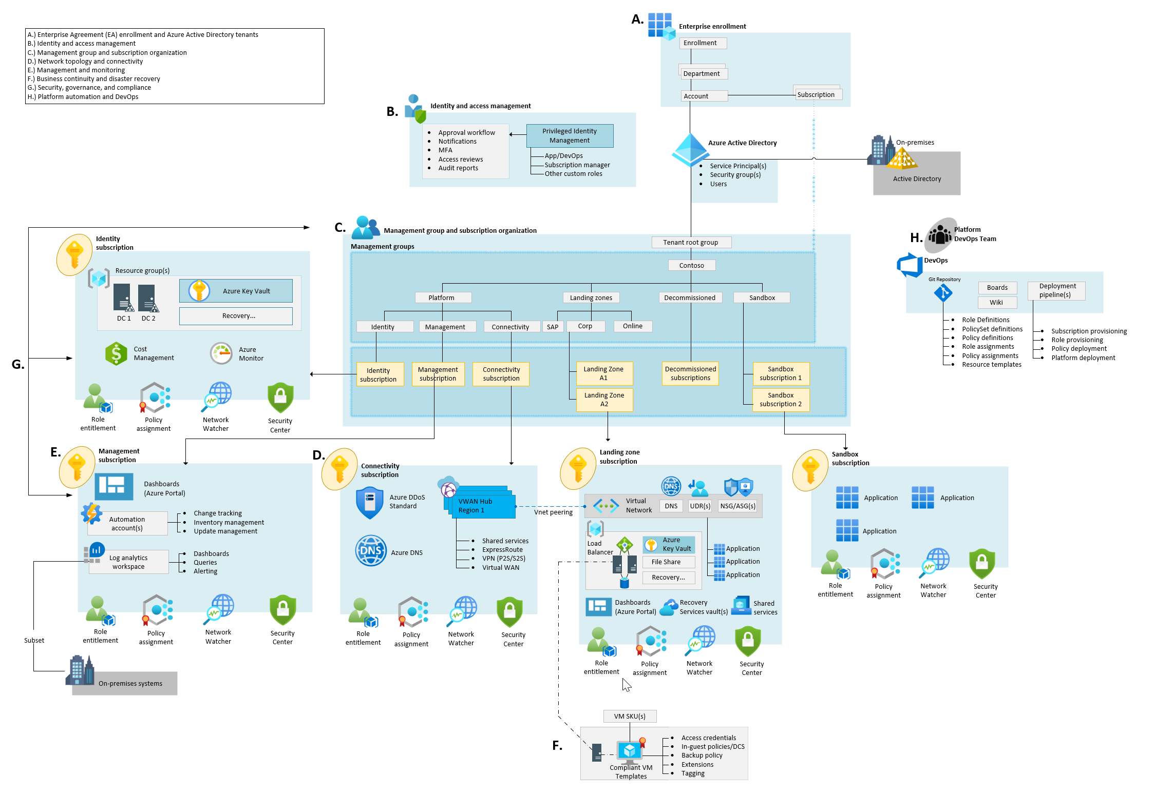

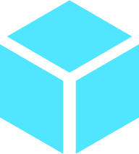

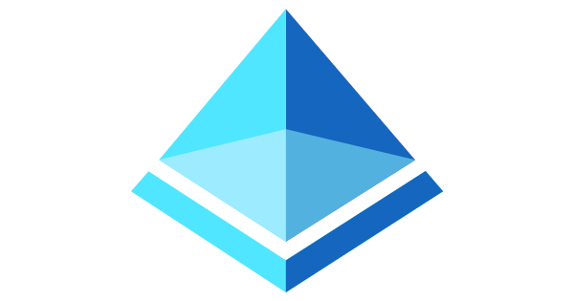


Implementation options – Architecture Deployed
Start small and expand
Deploy w/Azure Blueprints + ARM templates
Start with enterprise scale
Deploy w/Azure policy + ARM templates
CAF Migrate landing zone
Azure Subscription
Resource Group
Azure virtual network
Azure Active Directory
Storage accounts
Log Analytics
Key Vault
Azure Migrate
Core infrastructure services
Notes:
Whether you start with enterprise scale or Start small and expand we focus on core technical constructs that must be designed and developed within the context of your requirements to create compliant technical landing zone environments and the conditions for successful Azure adoption.
Identity and access management
Policy management
Management and monitoring
Network topology and connectivity
Shared services infrastructure
DevOps

Slide 22




Implementation options Third-party & Partner options
Azure Region 1
hub-core-sec
hub-operations
Diagnostics Logging
Activity Logs
Log Analytics
Network Monitoring
AD Assessment
AD Replication
Agent Health Assessment
DNS Analytics
Key Vault Analytics
Security Center
Partner landing zones
CAF Terraform modules
Validate a partner offer
Understand partners approaches and solution
Validate cloud operating model
Review partners solution for governance, security, and compliance
Review partners design, based on design areas
Deployment options for partner landing zone
Build on existing terraform skills
Path for multicloud operating models
Design Azure landing zones, based on design areas
Enable the community with a set of sample reusable landing zones
Deploy workloads to Azure
Notes:
The Cloud Adoption Framework approaches cloud adoption as a self-service activity. The objective is to empower each team that supports adoption through standardized approaches. In reality, you can't assume that a self-service approach is sufficient for all adoption activities.
Successful cloud adoption programs typically involve at least one level of third-party support.
Many cloud adoption efforts require support from a systems integrator (SI) or consulting partner who provides services that accelerate cloud adoption. Managed service providers (MSPs) provide enduring value by supporting landing zones and cloud adoption, but they also provide post-adoption operations management support. Additionally, successful cloud adoption efforts tend to engage one or more independent software vendors (ISV) who provide software-based services that accelerate cloud adoption. The rich partner ecosystems of SIs, ISVs, MSPs, and other forms of Microsoft partners have aligned their offerings to specific methodologies found in the Cloud Adoption Framework. When a partner is aligned to the Ready methodology of this framework, they will likely offer their own Azure landing zone implementation option.

Slide 23
Key customer landing zone requirements | Start small and expand Migration landing zone | Enterprise-scale Architecture Reference Implementation
Operating model alignment | Centralized Operations | Enterprise Operations
Timelines to reach security and compliance requirements for a workload | 4-6 months | 6-8 weeks
Provides a baseline architecture/environment | Simple starting point to build your own solution with minimal subscriptions (scale only as needed) | Yes, for the entire Azure tenant regardless of customer’s scale-point, includes cloud-native operations
Best-practices from cloud provider | Yes, Additional best practices added using CAF methodologies to apply security, governance, compliance | Yes
Be aligned with cloud provider’s platform roadmap | Yes | Yes
UI Experience | Yes, Azure Portal | Yes, Azure Portal
All critical services are present and properly configured according to recommend best practices for identity & access management, governance, security, network and logging | Partial. Some resources are deployed. Additional offerings aligned to CAF methodologies required to apply best practices to support security, governance, & compliance. | Yes, using a multi-subscription design, aligned with Azure platform roadmap
Automation capabilities (IaC/DevOps) | Yes: ARM, Policy, Blueprint Could create your own CICD pipeline | Yes: ARM, Policy, GitHub/AzureDevOps CICD pipeline option include
Provides long-term self-sufficiency | Requires CAF Govern and Manage methodologies to achieve long-term self-sufficiency. See trigger for ESLZ consideration. | Yes, enterprise-scale architecture -> 1:N landing zones Approach & architecture prepare the customer for long-term self-sufficiency, the RIs are there to get you started
Enables migration velocity across the organization | Depends. Requires CAF Govern and Manage methodologies to support sensitive data or mission critical workloads. There is a risk of extensive refactoring or even redeployment to deliver on those needs. | Yes, enterprise-scale architecture -> 1:N landing zones, Architecture includes designs for segmentation and separation of duty to empower teams to act within appropriate landing zones
Achieves operational excellence | Requires CAF Govern and Manage methodologies to achieve operational excellence | Yes. Enables autonomy for platform and application teams with a policy driven governance and management
Notes:
Watch this video to understand delivery of the table above

Slide 24
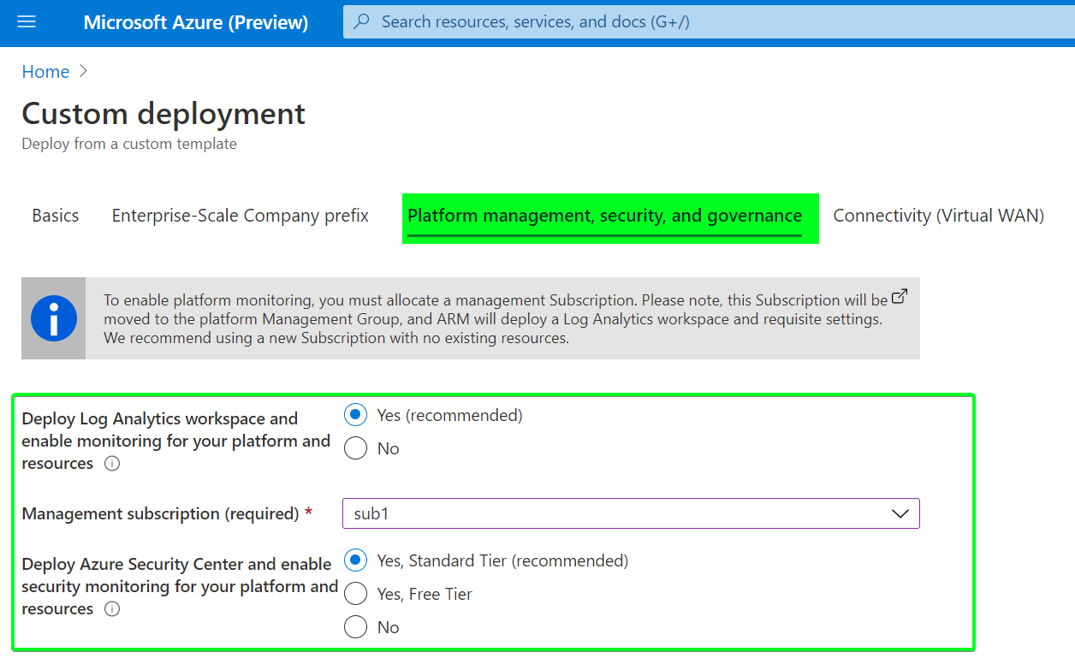
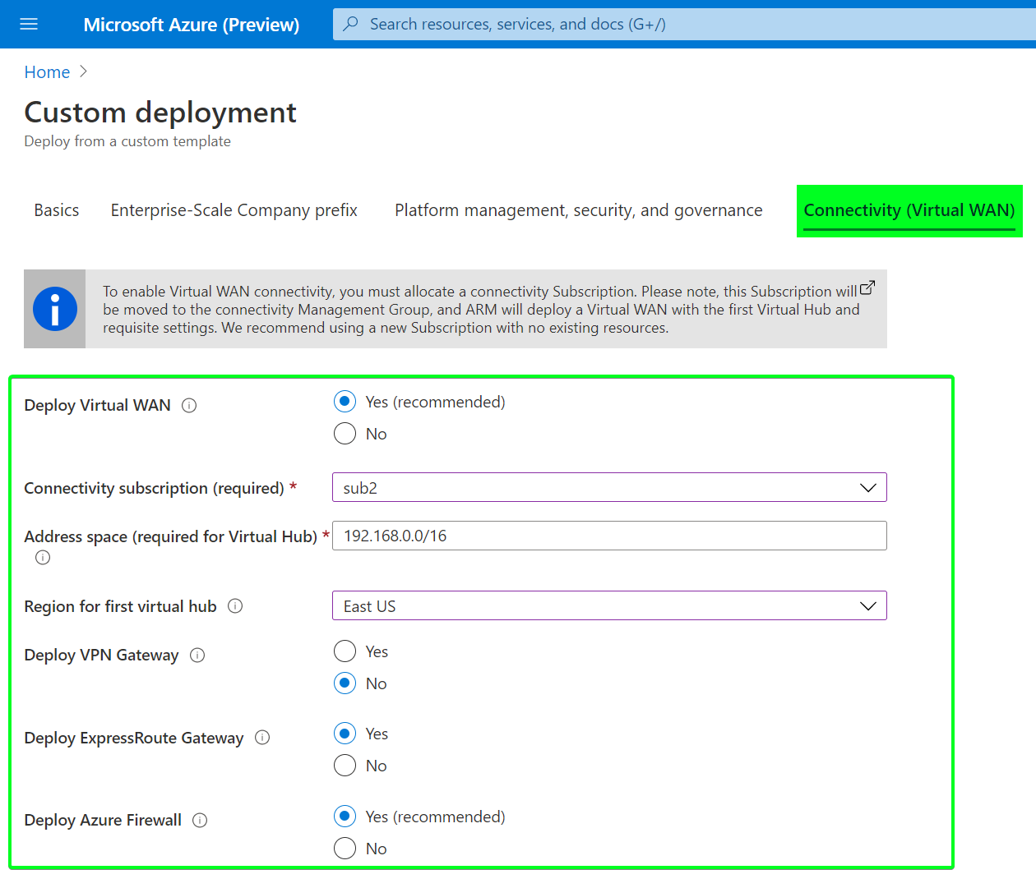

Getting started: Enterprise scale
Deploy Enterprise-Scale Reference implementation in your own environment
This section will guide you through the process of deploying Enterprise-Scale reference implementation in your own environment.
What is Reference Implementation?
Enterprise-scale design principles and implementation can be adopted by all customers no matter what size and history their Azure estate. The following customer reference implementations target different and most common customer scenarios for an Enterprise-Scale adoption.
Deploy Reference Implementation
Reference implementation | Description | ARM template | Link
WingTip | Azure Only |  | Detailed description
Contoso | On-premises connectivity using Azure vWAN |  | Detailed description
AdventureWorks | On-premises connectivity with Hub & Spoke |  | Detailed description
Deploy to Azure
Deploy to Azure
Deploy to Azure
Call to Action:
Review the Enterprise-scale landing zones Architecture guidance
Review the Enterprise-scale landing zones implementation guidelines
Review and deploy a reference implementation
Notes:
On June 15, we release ES in the CAF
Enterprise-scale Architecture in the CAF under Ready
3 Reference Implementations with a Portal based deployment experience using ARM Templates on GitHub
Call to action. Getting started with Enterprise Scale
Our goal to help you build a successful foundation in Azure for application and workloads.
Thanks you!

Slide 25
Resources to deploy cloud-ready environments
Read the Documentation on Azure landing zones
Azure Landing Zones
https://aka.ms/adopt/landingzones
Learn about Azure Landing Zones
Choose the best landing zone option
https://aka.ms/adopt/landingzones
Implement Enterprise-scale Landing Zones in Azure
Examples and GitHub resources for implementation
https://aka.ms/adopt/landingzones/enterprise-scale/implementation
Find partners to support Azure Landing Zone Implementation
Partners with Azure landing zone options
https://aka.ms/adopt/findapartner/ready
Notes:
<Key point>:What resources are available to guide you in designing and building your solution offerings? Here are some next steps:
<Talking Points>
<Transition>: Thank you

Slide 26
Thank you
Notes:
Thank You

